Slide 1
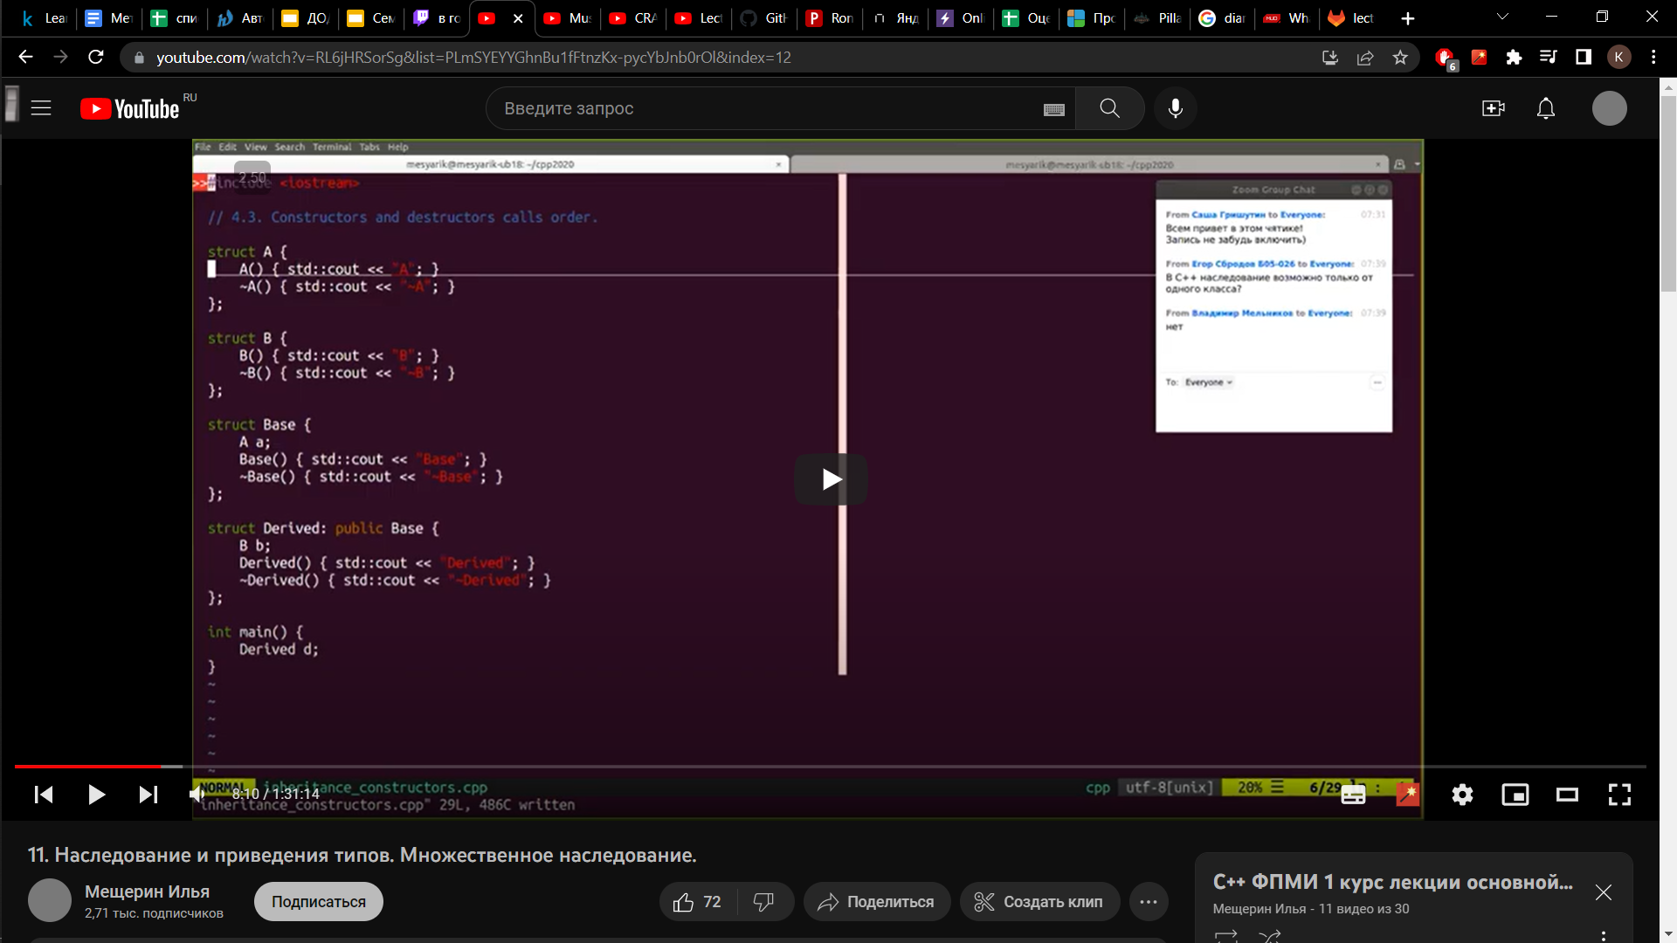
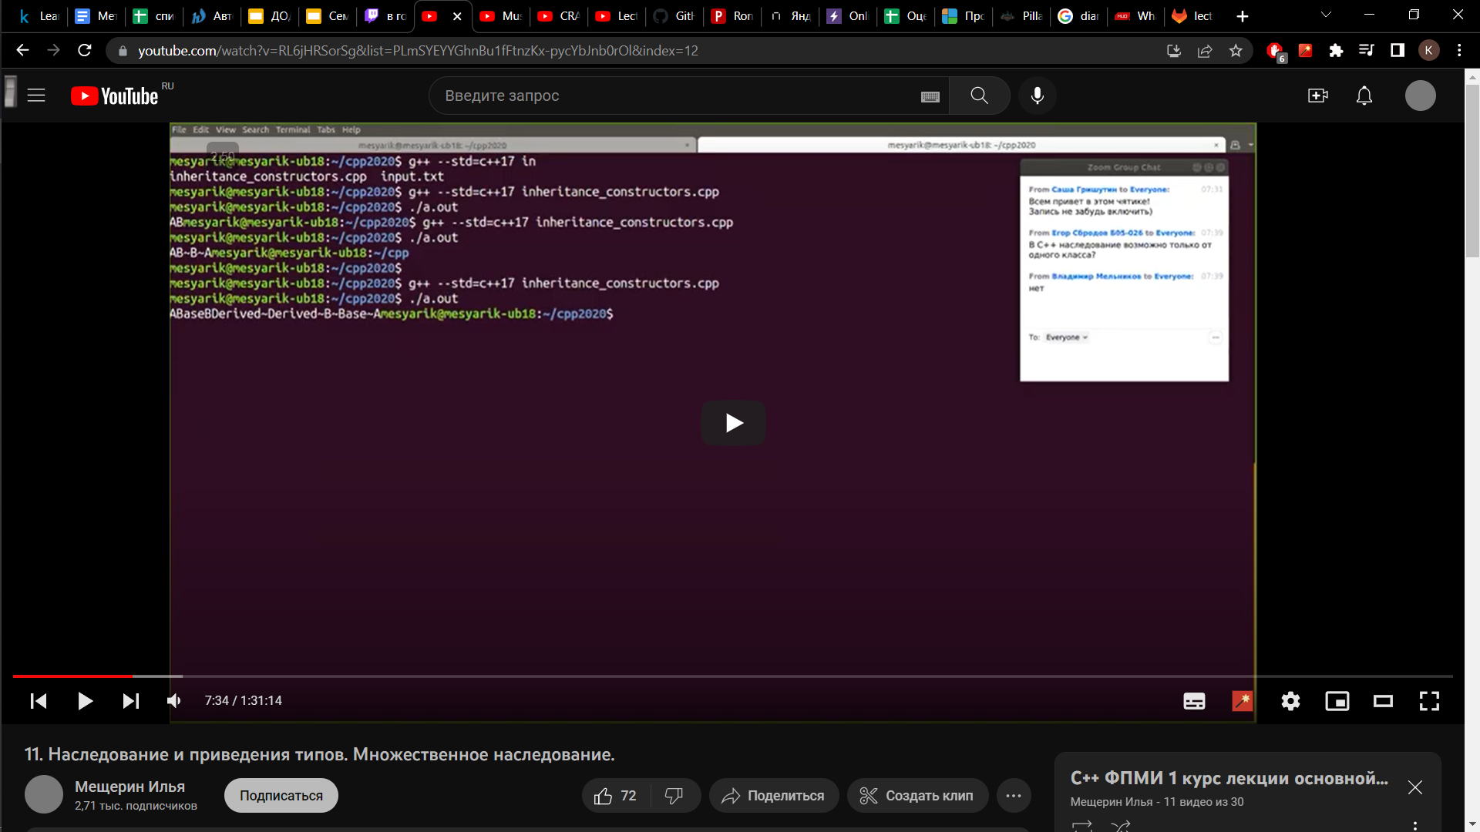
Constructors and destructors
The objects are constructed and destructed in a strict order
Firstly the constructor of the most base class is called, then the constructors
of the classes that inherits from base and so on
Destructors called in reverse order: firstly the most derived class is destroyed
If we have to construct some fields in the class (A/B in the example), they are
constructed before calling the constructor of the class itself,
and vice versa with destruction
Example: we created Derived d object, then we should firstly create Base part of “d”,
and for that we should call A constructor before Base constructor
The program ends, “d” gets destroyed: from calling the Derived destructor to
calling the A destructor

Slide 2
Inheritance: how does it work in memory?
Lets say we have the hierarchy:
Grandmother (have int g field) → Mother (have int m field) → Son (have int s field)
Then the representation in the memory will be:
[ Grandmother::g ] [ Mother::m ] [ Son::s ]
4 bytes 4 bytes 4 bytes

Slide 3
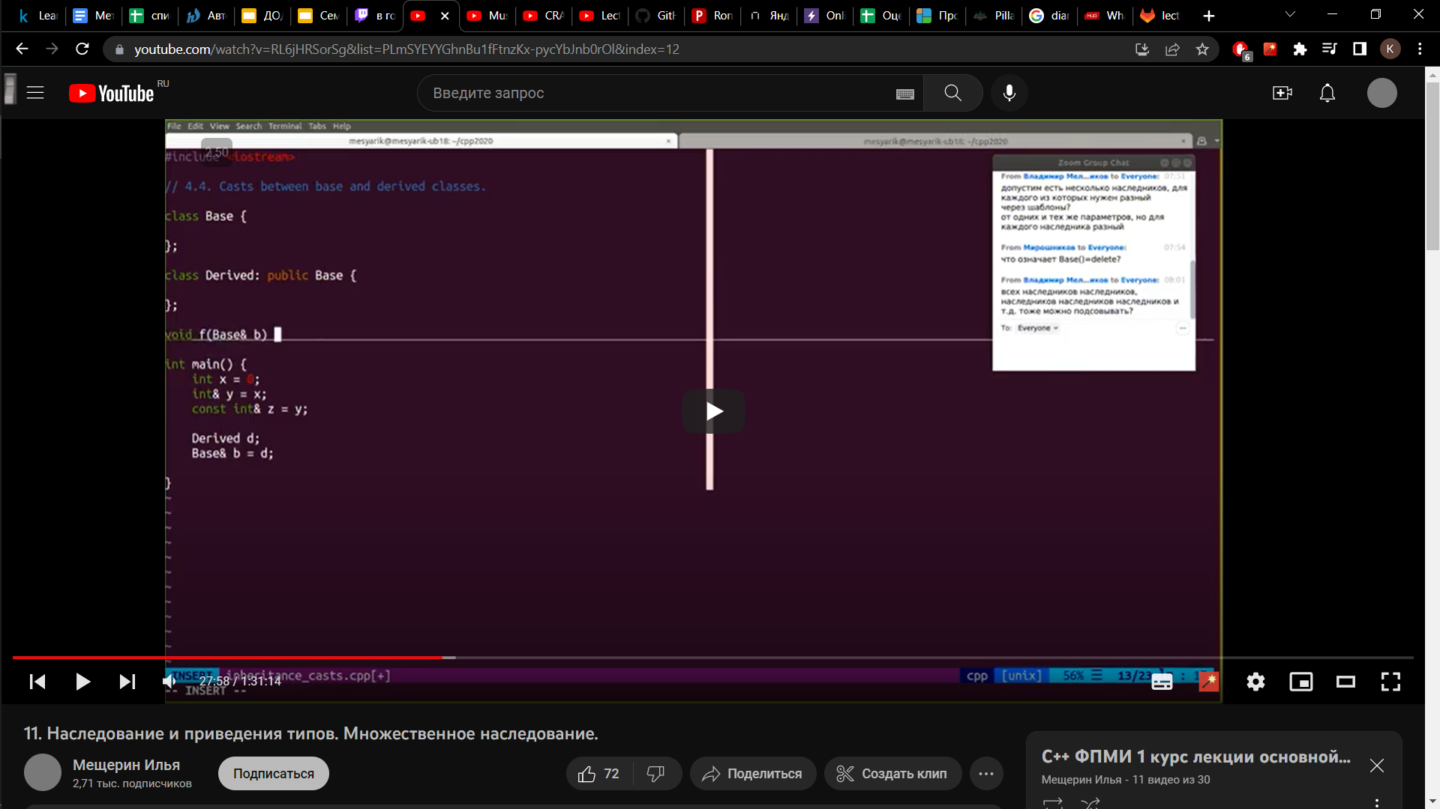
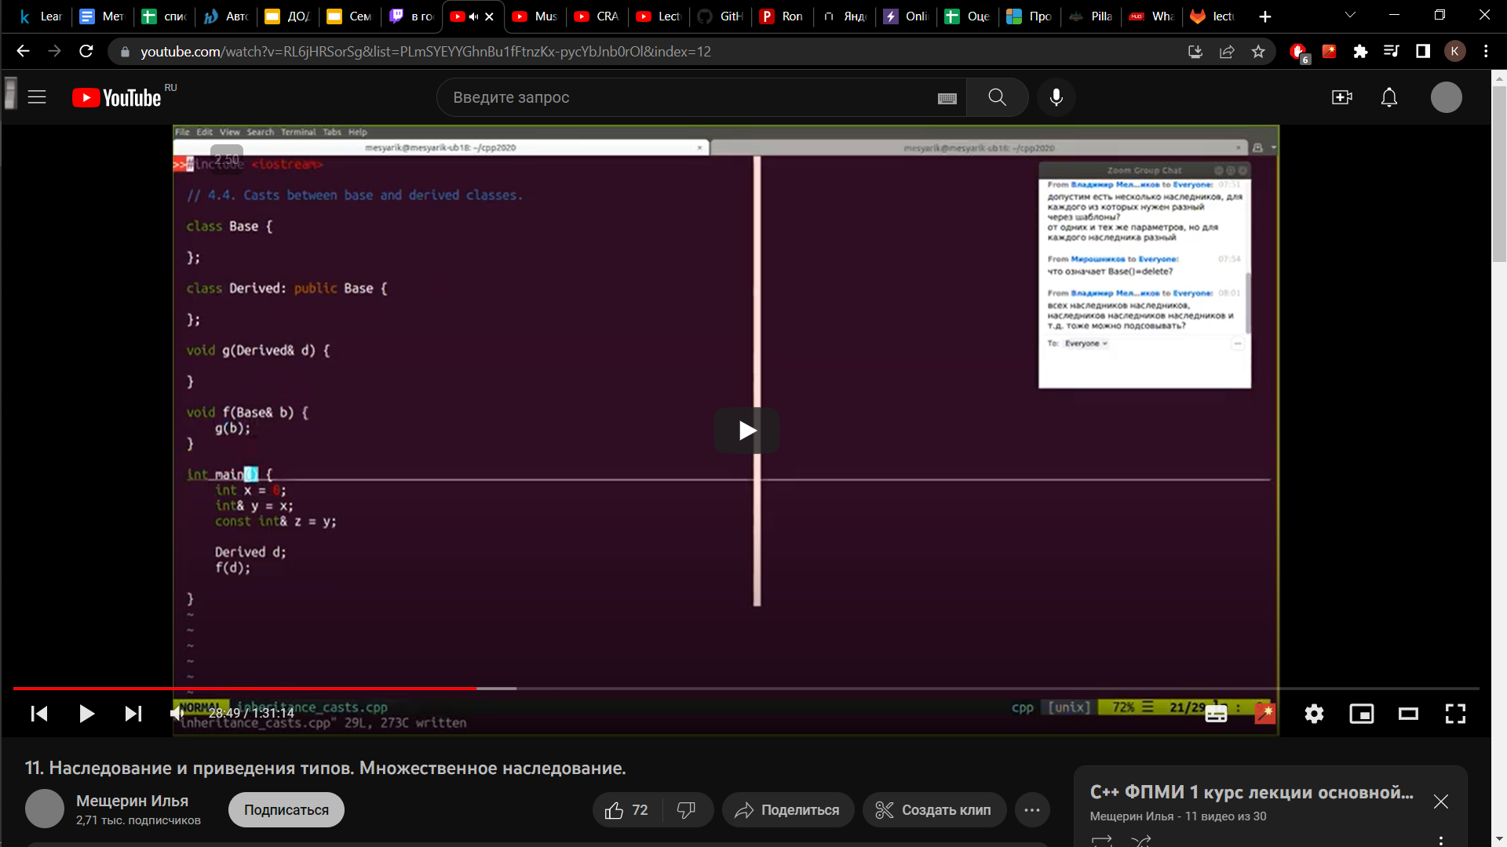

Liskov substitution principle (LSP)
a principle in object-oriented programming stating that an object (such as a class)
may be replaced by a sub-object (such as a class that extends the first class)
without breaking the program
The most simple example: we created reference to Base object and put there Derived object. “b” will act like a Base object using the part of the Derived that was inherited from Base (field, methods defined in the Base class)
We can’t do so in a reversed way: we can put Derived objects in f function, but can’t put Base in g.

Slide 4

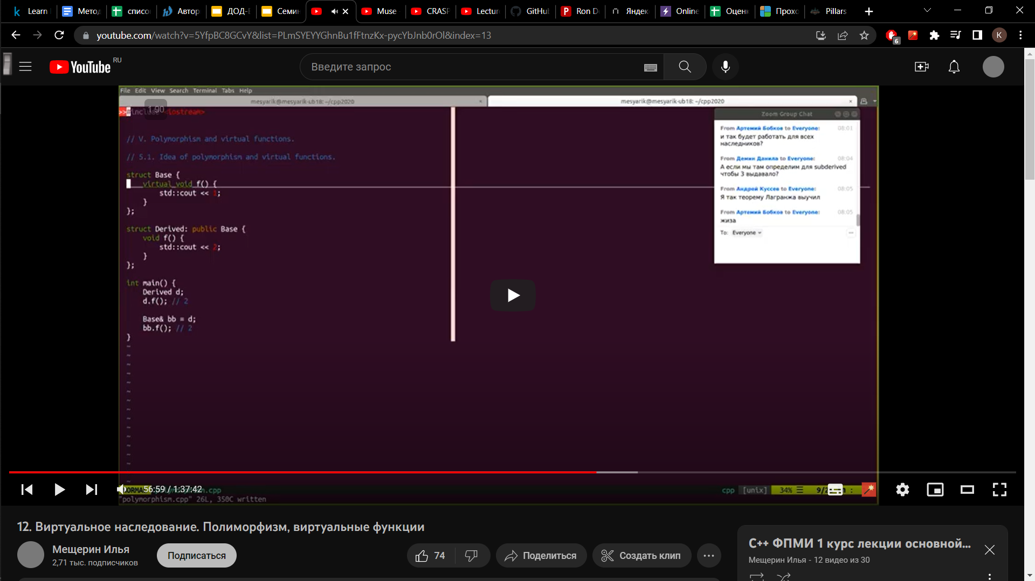
Virtual functions
Problem: when we are trying to access Derived object using
reference of type Base, we get the output
such as “d” was of type Base
This can be solved using by calling functions virtual
Now all redefinitions of “f” will be virtual functions
Notice: virtual functions should have the same signature!
If we will define void f() const {} in Derived, it won’t be virtual!
There are also two keywords for functions in classes
void f() final – means that function can’t be redefined in descendants
void f() override -- means that function must redefine some function of the ancestors (you will get an error if not)

Slide 5
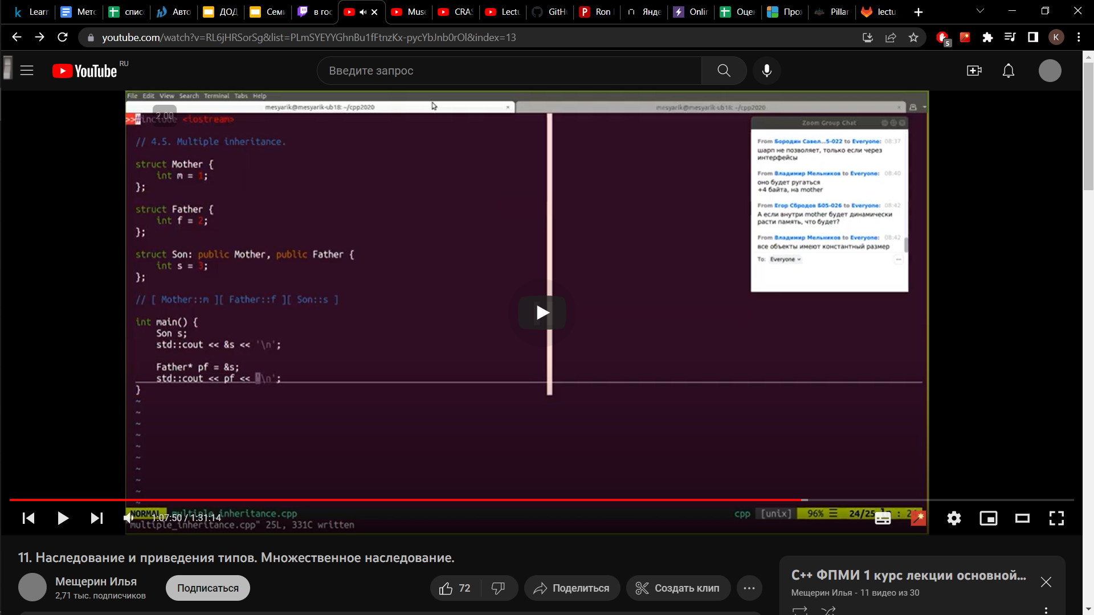
Multiple inheritance
Allowed in C++, Python
Not allowed in Java, C#
Why?
&s will point here
pf will point here
We casted Son type to Father type and got different
address, sometimes it can cause troubles

Slide 6
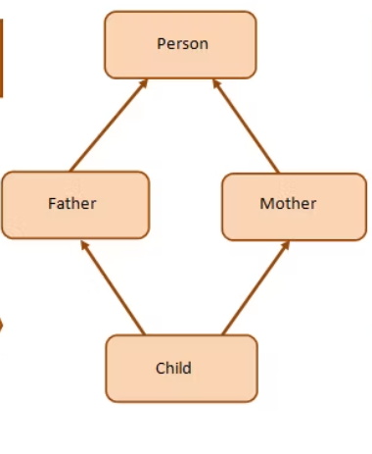
Diamond problem
int Age
char* Name
Problem: I want to access Child.Age, which Age I should use:
inherited by Mother or by Father?
Let’s see how the Son object is stored in memory:
[ Grandmother ] [ Mother ] [ Grandmother ] [ Father ] [ Son ]
Mother object
Father object
So we have two copies of Age and Name in the Son object
And thus we have ambiguous call trying to access this fields

Slide 7
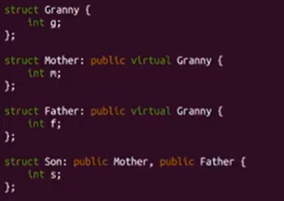
Virtual inheritance
The diamond problem can be solved using the virtual inheritance concept
Now we have such representation:
[ m_ptr ] [ m ] [ f_ptr ] [ f ] [ s ] [ g ]
Mother
Father
Both father and mother has an ancestor
but now it is the same object
The bad thing here is that pointers take additional memory
and Granny object can lie not only in the same block as all the Son object,
but somewhere else
[ m_ptr ] [ m ] [ f_ptr ] [ f ] [ s ] …….. [ g ]
and object become weird
However, it is the only way to solve diamond problem

